Slide 1





policy Strategies for the energy Transition
What they are about and how they are put into action. A contribution to the OECD Hackathon.
Andrea Zielinski
Florian Wittmann
Denilton Darold
Jan Rörden
David Howoldt

Slide 2
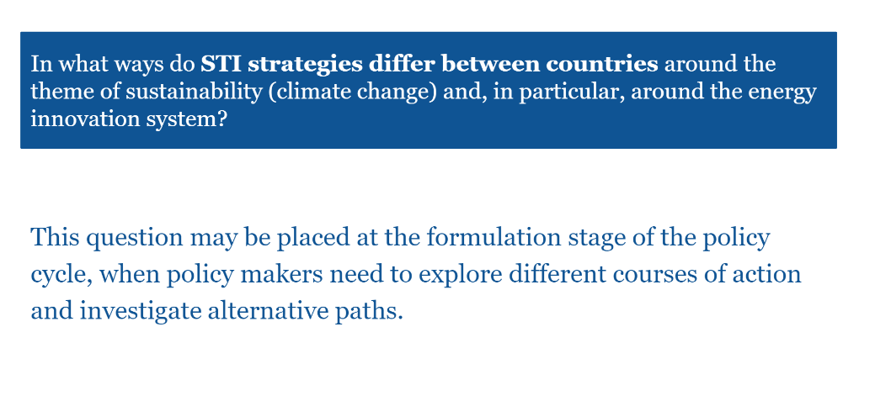

Slide 3
Approach
Pre-compile strategy corpus
Identify statements relevant
for energy transitions
Distinguish strategic approaches,
country-level comparison
Policy formulation
Consider how these approaches
are put into action in policy
initiatives
Trace these approaches
in the STIP Compass
Implications for policy design

Slide 4
Identify Relevant Statements in Strategies: How?
Considerations
Strategies are very heterogenous. Largest category: „Other national strategies implicating STI”. Most are from 2019-2021
Rather small share of relevant statements and passages in the corpus is relevant
Analysis at sentence-level
Use translated texts, not cleaned version
Semantic Analysis
Identify the most relevant sentences in the strategy corpus given a pivot sentence (similarity score > 0.6)
Pivot sentence: Definition of energy transitions from the STIP Compass (Theme 92)
Clean energy is understood as "low-carbon energy". Clean energy innovation policies, strategies and/or programmes (e.g. developments in energy, climate, and S&T policies and strategies, new major R&D and demonstration projects, new support schemes for clean energy inventors and entrepreneurs) aiming to contribute to achieving net-zero CO2 emissions (i.e. deep decarbonisation), in any supply-side or end-use sector (e.g. power and heat generation, industry, transport, buildings). Specific attention may be given to policies, strategies and/or programmes focusing on hard-to-decarbonise sectors where key technologies for decarbonisation are relatively less mature (e.g. heavy industry such as iron and steel and cement; long-distance transportation such as shipping and aviation), or on key emerging low-carbon energy technologies (e.g. low-carbon hydrogen, carbon capture, utilisation and storage, advanced biofuels).
Ref: Reimers, Nils, and Iryna Gurevych. "Sentence-bert: Sentence embeddings using siamese bert-networks." arXiv preprint arXiv:1908.10084 (2019)

Slide 5
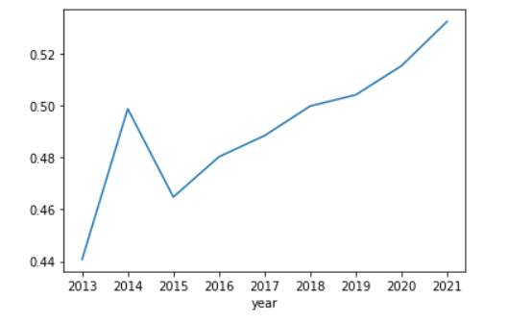
Identify Relevant Statements in Strategies: Results
Sentences most similar to pivot sentence
Average similarity of sentences to definition
Research and experimental development in LOW CARBON TECHNOLOGIES, including, as a priority, applications in the transformation industries of large consumption energy, in order to improve efficiency in the consumption of energy and resources and reduce the environmental impact of such activities.
Specifically, Axis 1.1 - Transition to a new environmentally friendly energy model promotes the transition to a low-carbon energy system, with a package of investments and reforms aimed at reducing greenhouse gas emissions, increasing the share of RES in final energy consumption and improving energy efficiency.
Contribution to the digital transition: 0% (has no impact) This programme responds to strategic objective 2 \"a greener Europe with low carbon emissions by encouraging a clean and fair energy transition, green and blue investments, the circular economy, adaptation climate change and risk prevention and management \"mentioned in appendix 1 of the European regulation laying down provisions common to European funds and corresponds to type of intervention 026\" Renovation or steps to increase the energy efficiency of public infrastructure, demonstration projects and support measures \".

Slide 6
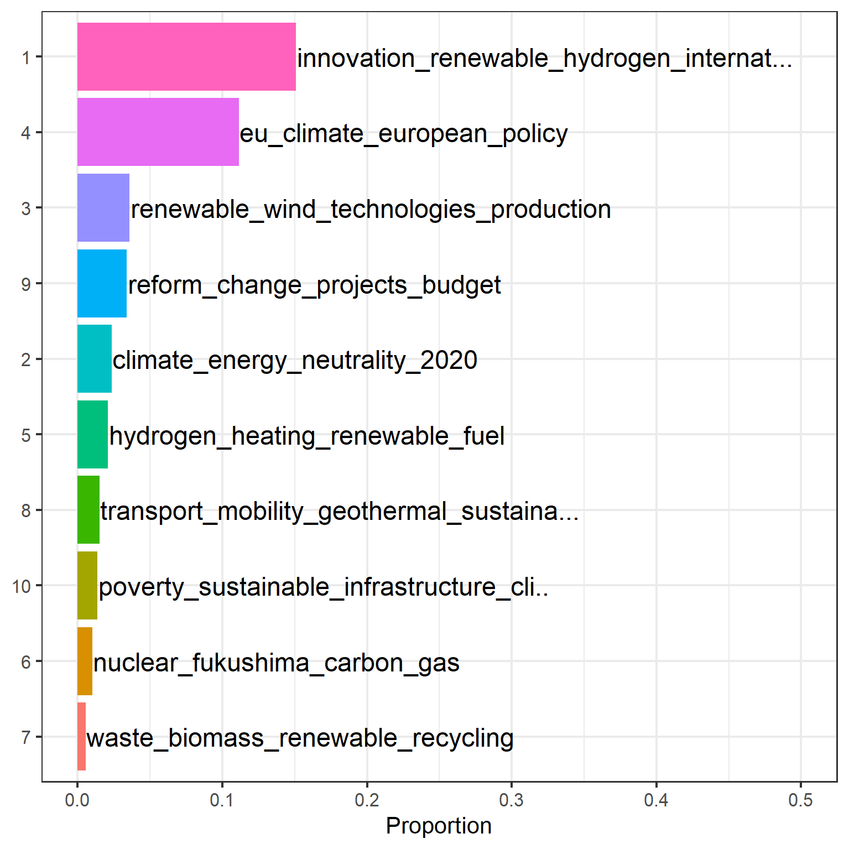
Distinguish Strategic Approaches and Compare Countries
BERT Topic Model with 11 topics
Based on sentences identified in previous step
10 useful topics, 1 „garbage“-topic
Ref: Grootendorst, Maarten. BERTopic: Neural topic modeling with a class-based TF-IDF procedure." arXiv preprint arXiv:2203.05794 (2022)

Slide 7
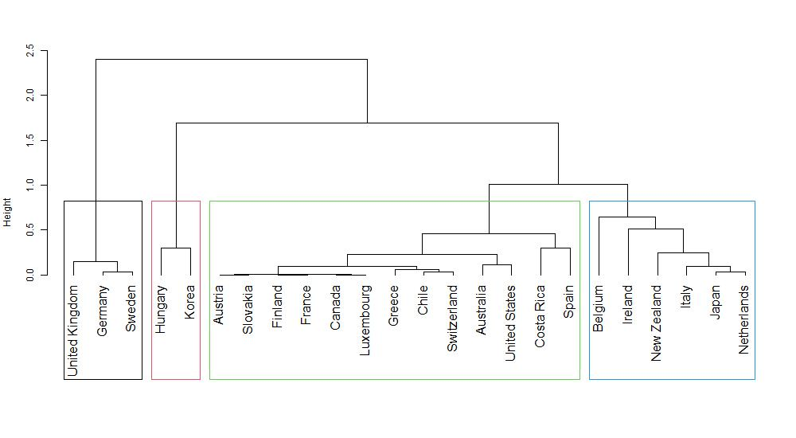
Country Clusters Based on Strategy Topic Model

Slide 8
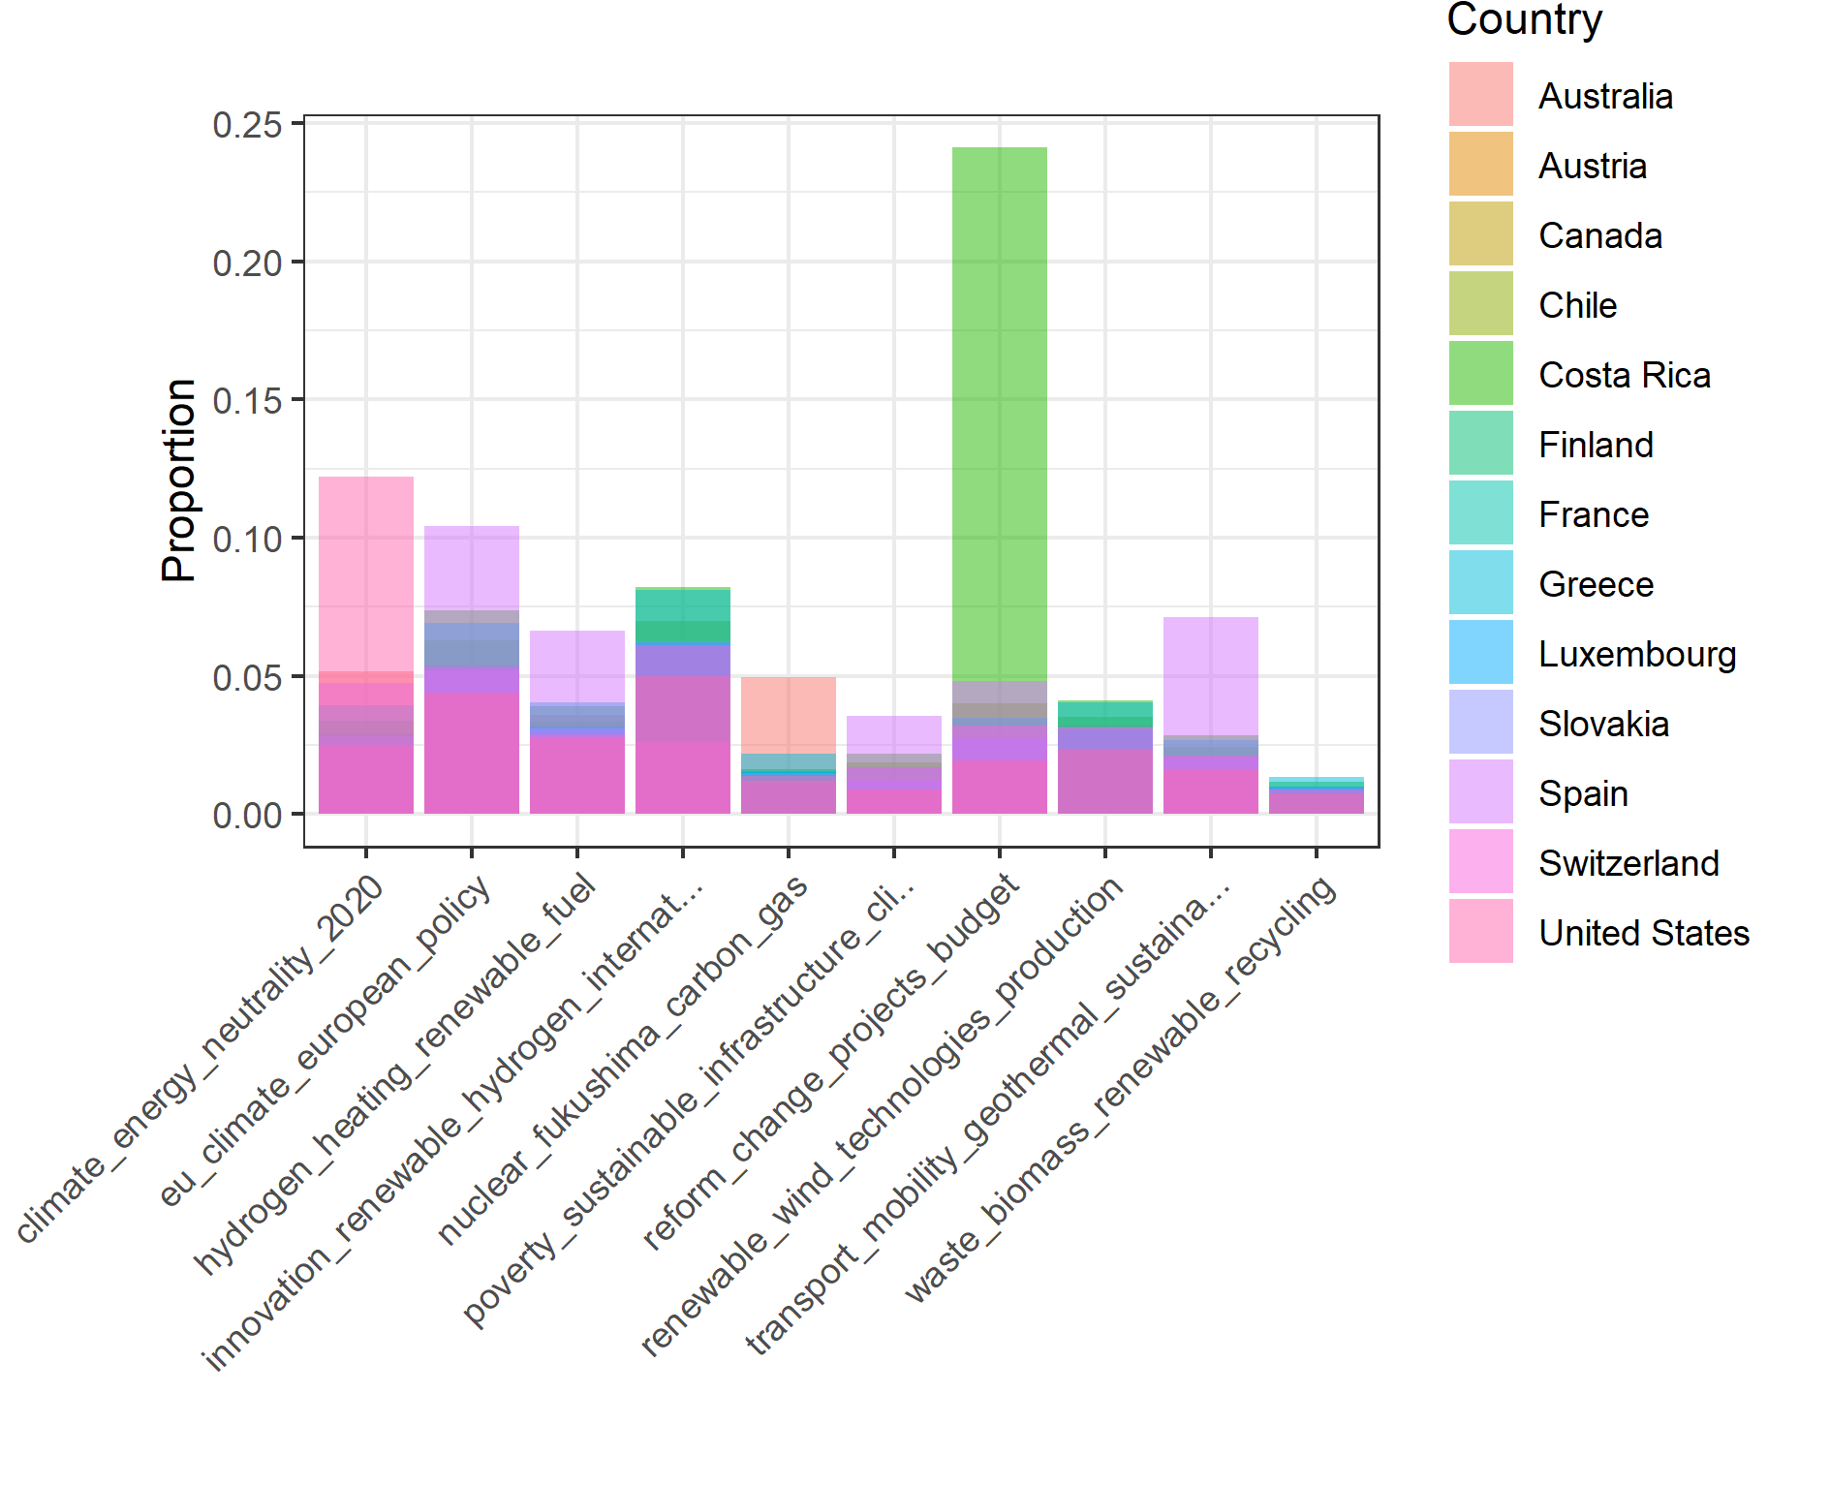
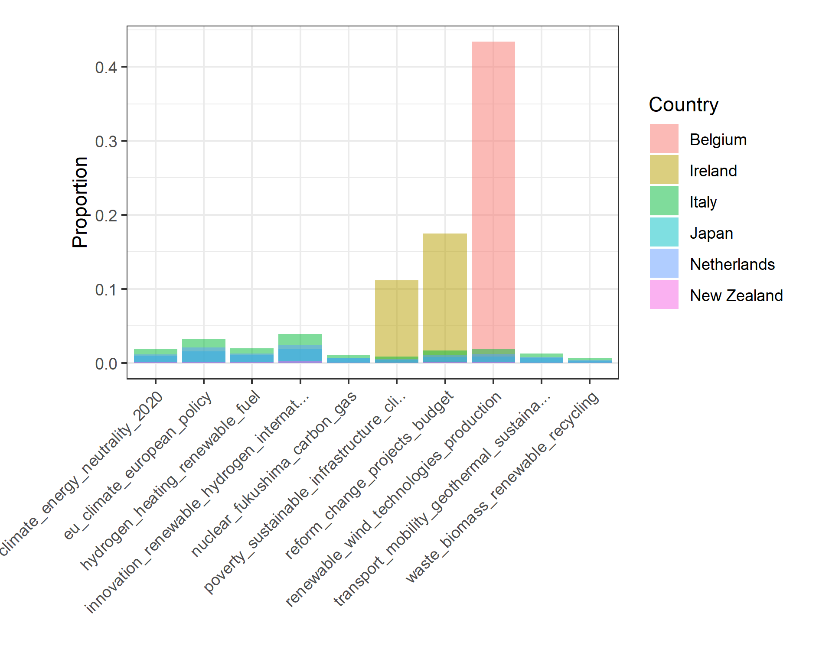
Strategy Topic Model: Country Clusters 1 & 2

Slide 9
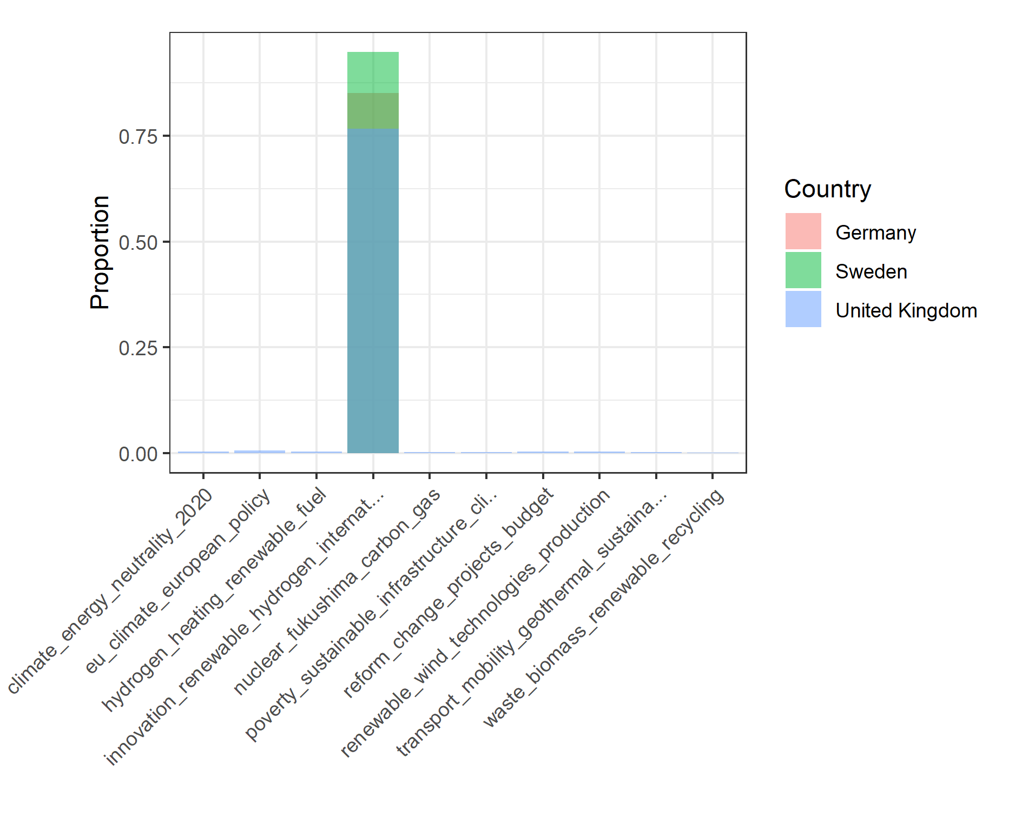
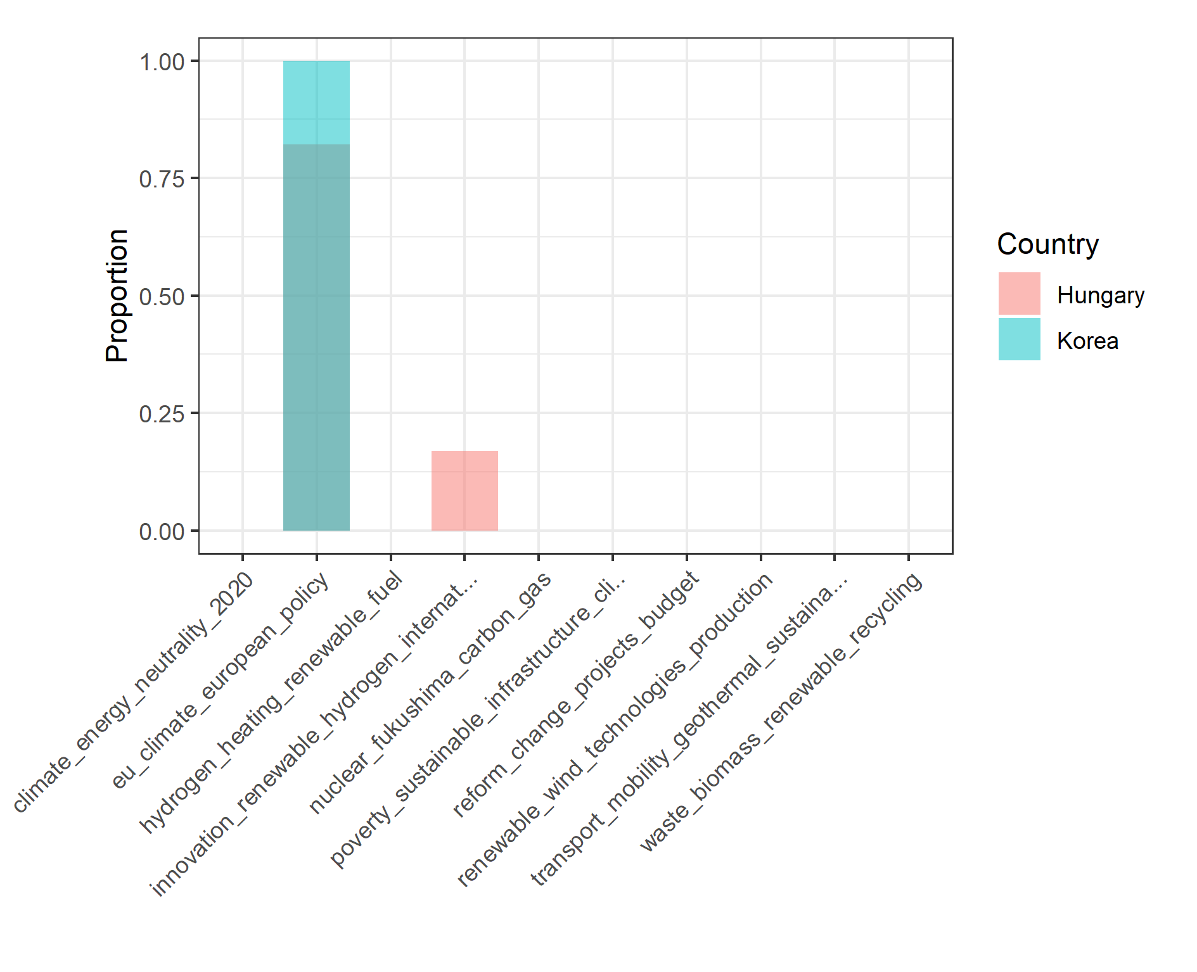
Strategy Topic Model: Country Clusters 3 & 4

Slide 10
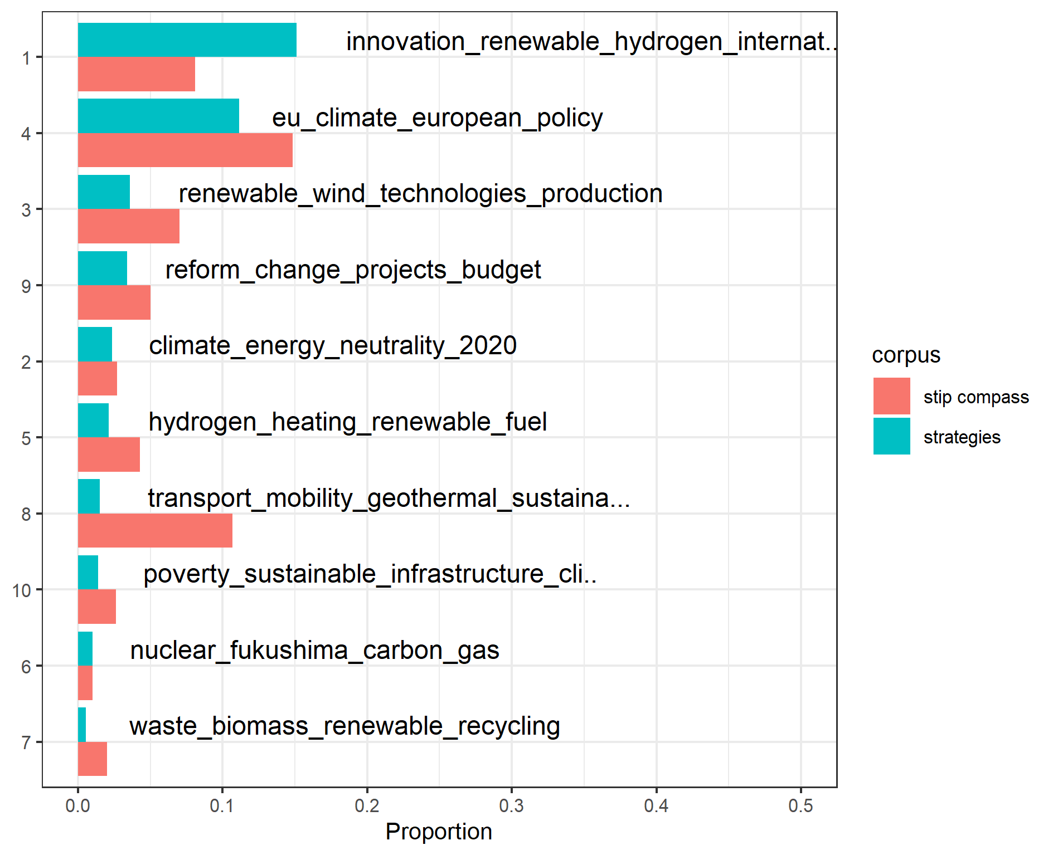
Tracing Strategic Approaches in the STIP Compass
Guiding question: How could differing strategies for the energy transition be put into action?
Approach
Applying topic model to STIP Compass
Focus on best-fit initiatives for the topics and consider distribution of:
Instrument types
Target groups
Policy mix themes
Topic Proportions Compared

Slide 11
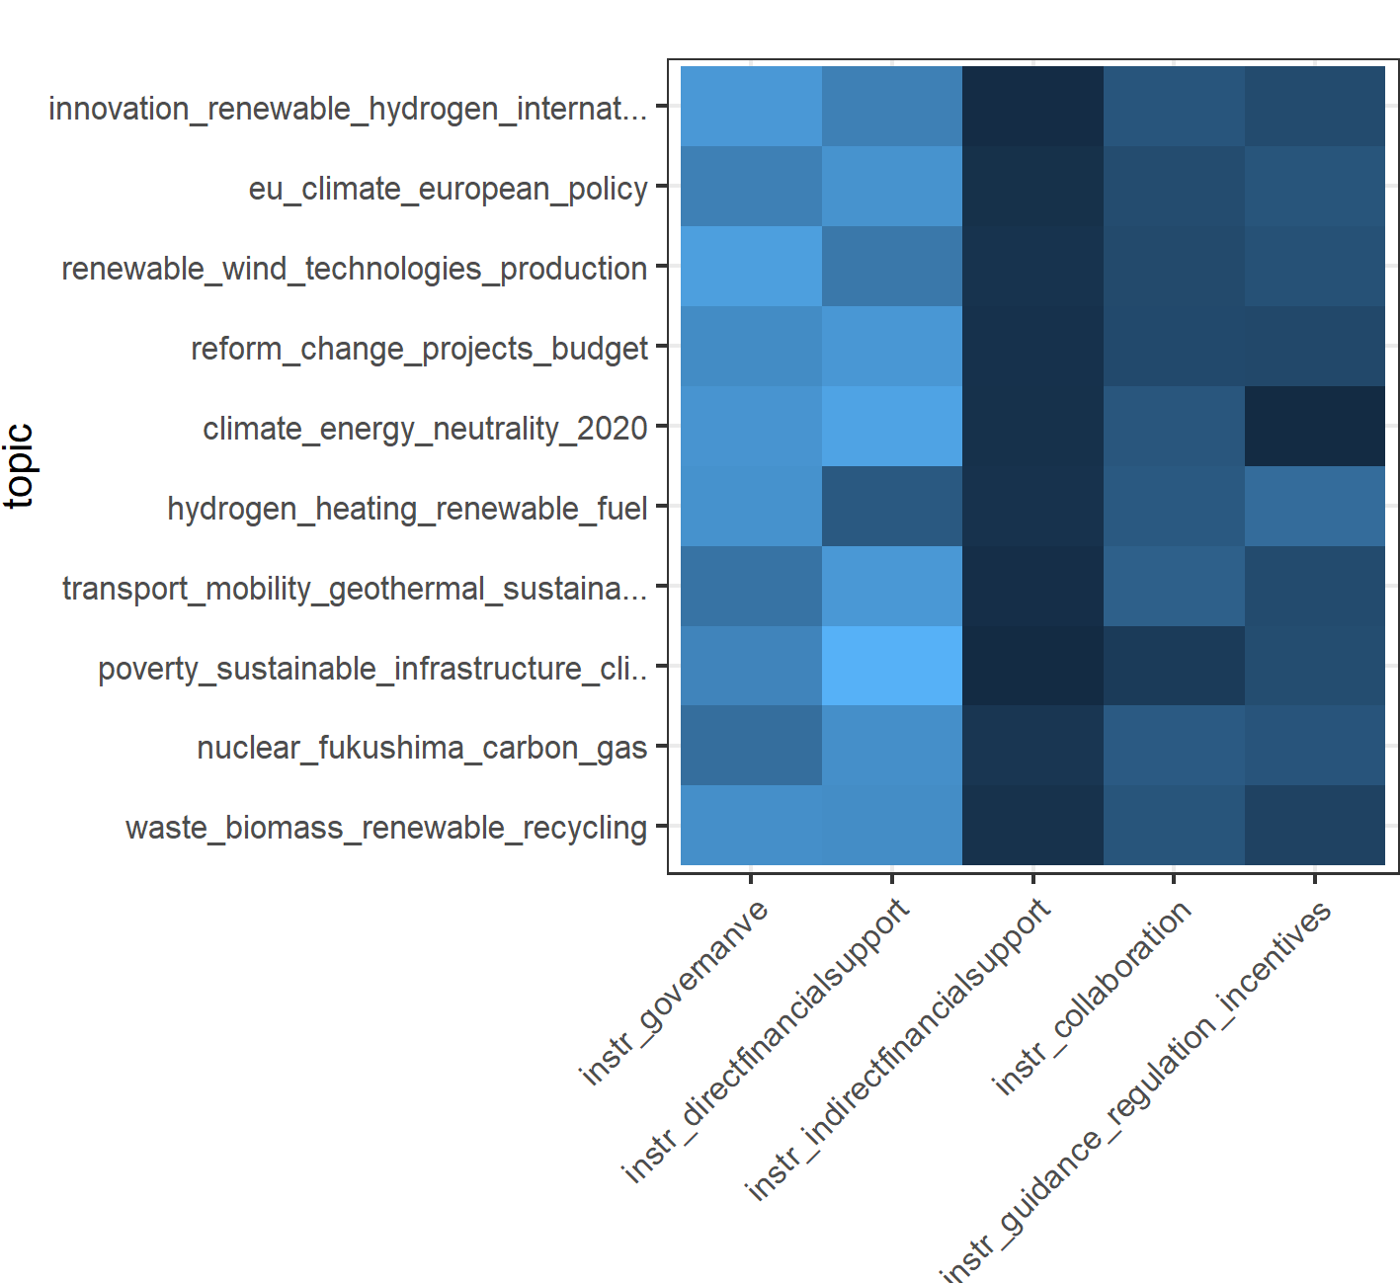
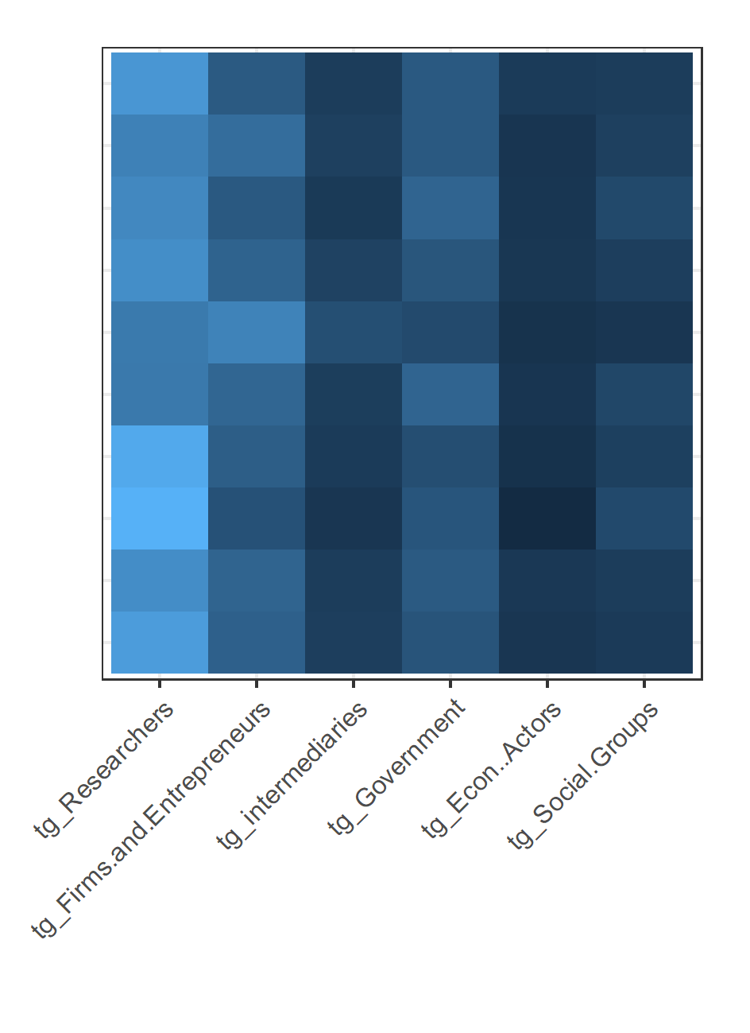
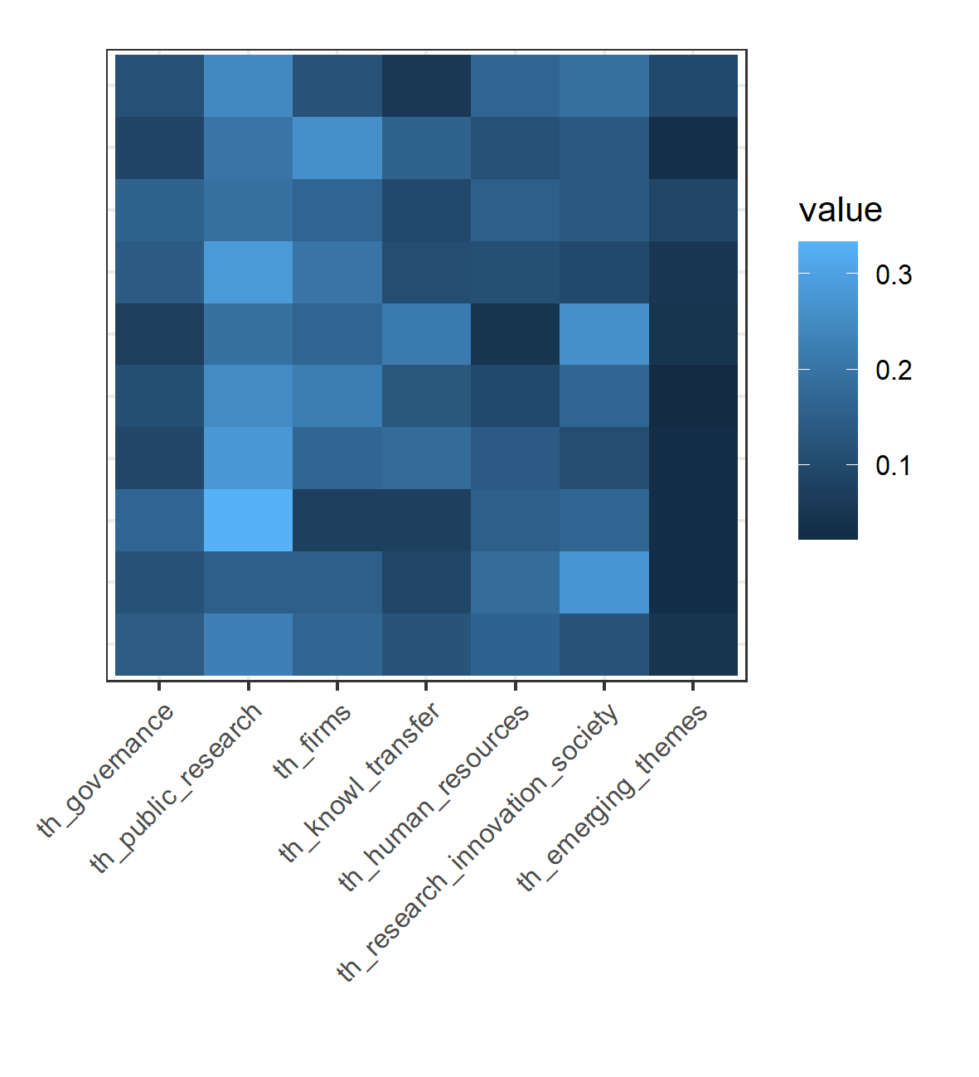
Tracing Strategic Approaches in the STIP Compass
Instrument types
Target groups
Policy mix themes

Slide 12
Conclusion
Take-aways
Identified strategic approaches to the energy transition and explored implications for policy design
This might allow to derive policy intelligence from the datasets without country-level analysis (a plus given data limitations)
Preliminary findings
Country differences: Diversified vs more focused strategic approaches
Some more concrete approaches receive more emphasis in policy initiatives that in strategies
Policy design related to these approaches differs in terms of instrument types, target groups, policy mix areas
Further work
What factors relate to the focus on different strategic approaches to the energy transition?
What explains differences in policy design related to these approaches?

Slide 13
Thank you!

